Slide 1

ESE 4009
INSTRUCTOR: Prof. Mike Aleshams
Group 6

Slide 2

Project :
Iot based cradle using SIDS monitor

Slide 3
Humidity sensor-DHT11 Interfacing with Raspberry pi
Presented by :Vandana Eaga-C0777215

Slide 4
Table of Contents
DHT11 sensor Introduction
DHT11 Sensor Pinout and description
DHT11 Specifications
Applications
Components Required
Connecting Components
Connecting Raspberry pi to putty
VNC viewer
Installing WiringPi
Compiling code
Programming DHT11 with C
References

Slide 5
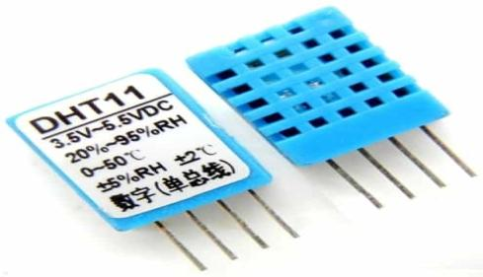
DHT11 Sensor
The DHT11 is a basic, ultra low-cost digital temperature and humidity sensor. It uses a capacitive humidity sensor and a thermistor to measure the surrounding air and spits out a digital signal on the data pin (no analog input pins needed). The temperature range of DHT11 is from 0 to 50 degrees Celsius with a 2-degree accuracy. The humidity range of this sensor is from 20 to 80% with 5% accuracy.

Slide 6
DHT11 Sensor
For temperature measurement, it has a thermistor embedded in it, which is a resistive and wet NTC temperature measuring device.
It works with both 3.3V and 5V microcontroller systems.
This sensor has excellent quality, fast response time and anti interference ability.
In DHT11, calibration coefficients are already stored in OTP program Memory, we just have to call these calibration coefficients while the internal sensors detect signal in the process.
It uses low power in transmitting simple signals up to 20 meters.
It comes in a single package comprising of 4 pins with 0.1" spacing between them and special package can be provided according to user demand.

Slide 7
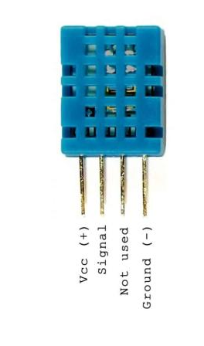
DHT11 Sensor Pinout and description
DHT11 sensor has four pins
Pin | Type | Parameters
Pin1 | VCC | This pin is used for input purpose at this pin we apply 3.3 v to 5v input supply.
Pin2 | Data pin | By this pin we get output of temperature and humidity values, by serial transmission protocol.
Pin3 | Not used | Not Connected.
Pin4 | Ground | This pin is used for Ground ( Connected to 0V or GND ).

Slide 8
DHT11 Specifications:
Accuracy:±5%
Humidity Range:20 ~ 80% RH
Mounting Type:Through Hole
Operating Temperature:0°C ~ 50°C
Output:16b
Output Type:Digital
Package / Case:Housed Sensor
Response Time:1s
Sensor Type:Humidity, Temperature
Voltage - Supply:3V ~ 5V

Slide 9
Applications
DHT11 Temperature and Humidity Sensor is one of the popular sensor modules used for implementing in a lot of IoT Projects. This sensor along with Raspberry Pi can also be used in:
HVAC Systems
Thermostats
Home and Office Climate Control
Weather Station

Slide 10
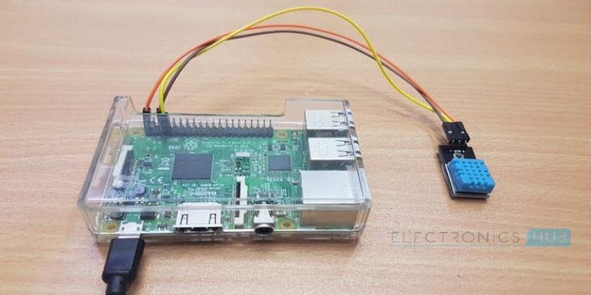
DHT11 interfacing with Raspberry pi

Slide 11
Components Required
Raspberry Pi 3 Model B
DHT11 Temperature and Humidity Sensor
10k ohm pull up resistor
Connecting Wires
Bread board
Power Supply
Computer

Slide 12
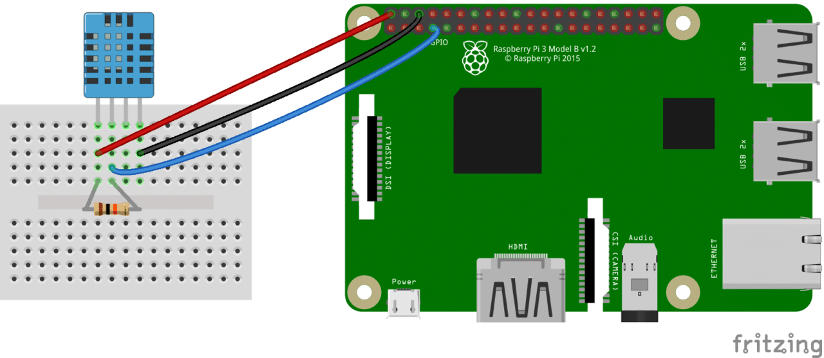
Connecting Components
DHT11 Sensor Vcc+ to Raspberry Pi 5V
DHT11 Sensor GND to Raspberry Pi GND
DHT11 Sensor Signal to Raspberry Pi PIN 7 (GPIO PIN 4)
10K Ohm Resistor between DHT11 PIN 1 and PIN 2

Slide 13
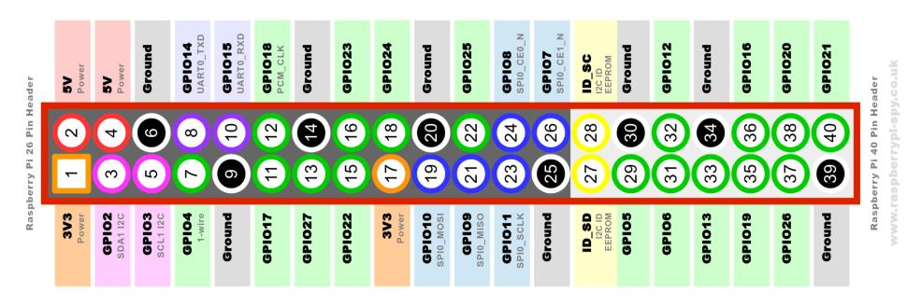
Raspberry pi pin layout

Slide 14
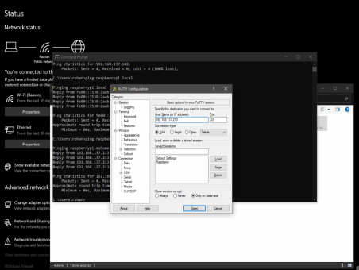
Connecting Raspberry pi to putty
Start putty and we will see the IP address and enter the address.
After that you will see the login prompt.
The default login for Raspberry Pi OS is pi with the password raspberry

Slide 15
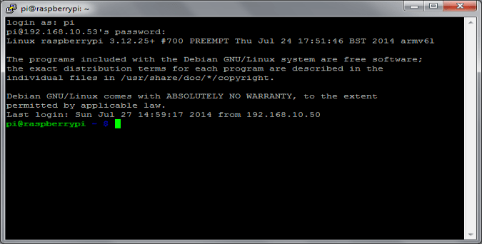
Connecting Raspberry pi to putty

Slide 16
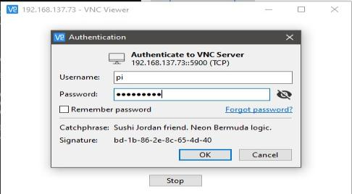
VNC viewer
To login to the device we use default username is “pi” and password is “raspberry”.

Slide 17

VNC viewer

Slide 18
Installing WiringPi
In order to do programming with C we need to install Wiringpi
To obtain WiringPi using GIT:
git clone git://git.drogon.net/wiringPi
If you have already used the clone operation for the first time, then
cd wiringPi
git pull origin
Will fetch an updated version then you can re-run the build script below.
To build/install there is a new simplified script:
cd wiringPi
./build

Slide 19
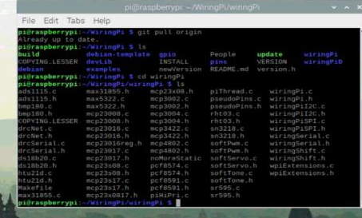

Installing WiringPi

Slide 20
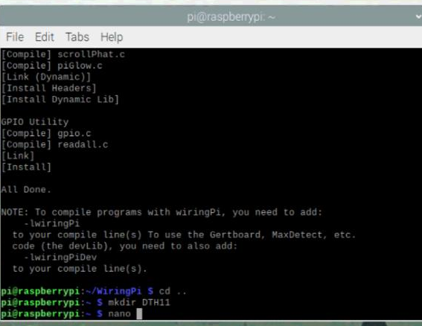
Making DHT11 Directory
mkdir DHT11

Slide 21
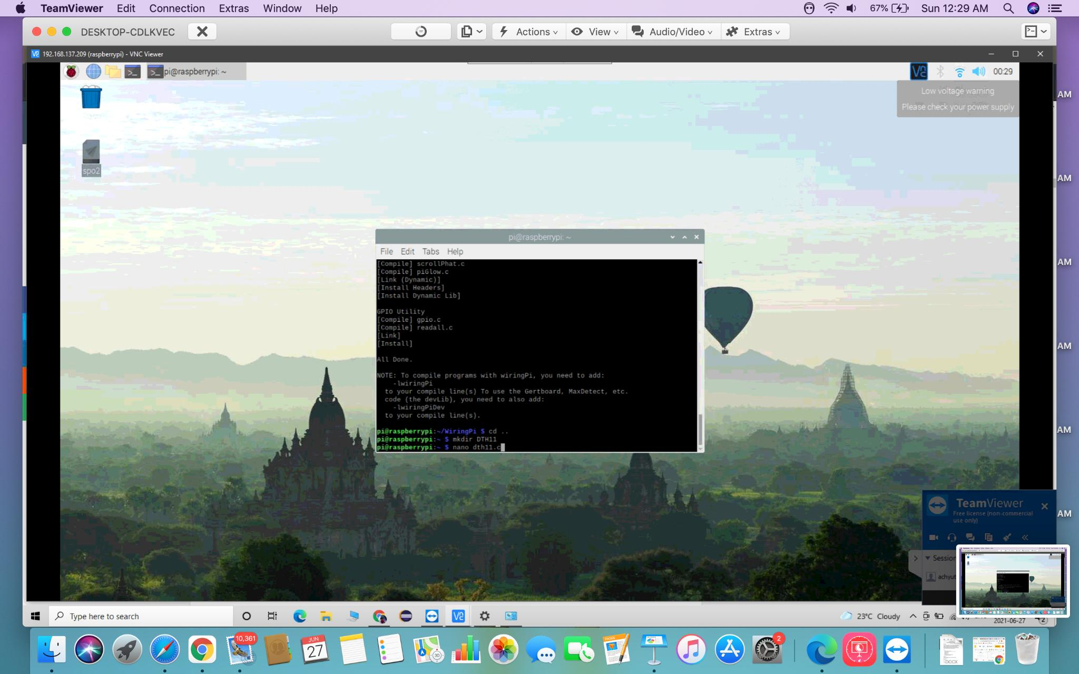
Creating a nano editor for dht11
nano dht11.c
We create a nano editor and insert the c code and save it and exit

Slide 22
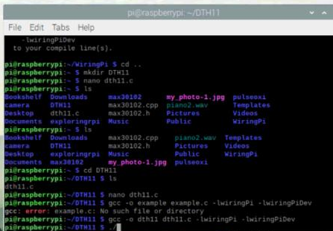
Compiling the code
The program can be compiled with this gcc command
gcc -o dht11 dht11.c -lwiringPi -lwiringPiDev
By using this command on the SSH terminal we can see the output of humidity and temperature (in °C and °F) readings
sudo ./dht11

Slide 23
PROGRAMMING THE DHT11 WITH C
/* * dht11.c: * Simple test program to test the wiringPi functions * DHT11 test */ #include <wiringPi.h> #include <stdio.h> #include <stdlib.h> #include <stdint.h> #define MAXTIMINGS 85 #define DHTPIN 7 int dht11_dat[5] = { 0, 0, 0, 0, 0 }; void read_dht11_dat() { uint8_t laststate = HIGH; uint8_t counter = 0; uint8_t j = 0, i; float f; /* fahrenheit */ dht11_dat[0] = dht11_dat[1] = dht11_dat[2] = dht11_dat[3] = dht11_dat[4] = 0;

Slide 24
PROGRAMMING THE DHT11 WITH C
/* pull pin down for 18 milliseconds */ pinMode( DHTPIN, OUTPUT ); digitalWrite( DHTPIN, LOW ); delay( 18 ); /* then pull it up for 40 microseconds */ digitalWrite( DHTPIN, HIGH ); delayMicroseconds( 40 ); /* prepare to read the pin */ pinMode( DHTPIN, INPUT ); /* detect change and read data */ for ( i = 0; i < MAXTIMINGS; i++ ) { counter = 0; while ( digitalRead( DHTPIN ) == laststate ) { counter++; delayMicroseconds( 1 ); if ( counter == 255 ) { break; } }/* ignore first 3 transitions */ if ( (i >= 4) && (i % 2 == 0) ) {

Slide 25
PROGRAMMING THE DHT11 WITH C
/* shove each bit into the storage bytes */ dht11_dat[j / 8] <<= 1; if ( counter > 16 ) dht11_dat[j / 8] |= 1; j++; } } /* * check we read 40 bits (8bit x 5 ) + verify checksum in the last byte * print it out if data is good */ if ( (j >= 40) && (dht11_dat[4] == ( (dht11_dat[0] + dht11_dat[1] + dht11_dat[2] + dht11_dat[3]) & 0xFF) ) ) { f = dht11_dat[2] * 9. / 5. + 32; printf( "Humidity = %d.%d %% Temperature = %d.%d *C (%.1f *F)\n", dht11_dat[0], dht11_dat[1], dht11_dat[2], dht11_dat[3], f ); }else { printf( "Data not good, skip\n" ); } }

Slide 26
PROGRAMMING THE DHT11 WITH C
int main( void ) { printf( "Raspberry Pi wiringPi DHT11 Temperature test program\n" ); if ( wiringPiSetup() == -1 ) exit( 1 ); while ( 1 ) { read_dht11_dat(); delay( 2000 ); /* wait 1sec to refresh */
} return(0); }

Slide 27
References
DHT11–Temperature and Humidity Sensor. (2018, January 05). Digi-key Electronics. https://components101.com/sensors/dht11-temperature-sensor
Zahid Ali. (2019, March 05). Introduction to DHT11. The Engineering Projects. https://www.theengineeringprojects.com/2019/03/introduction-to-dht11.html
DEREK MOLLY. (2016). Exploring Raspberry pi. WILEY. https://www.amazon.ca/Exploring-Raspberry-Pi-Interfacing-Embedded/dp/1119188687

Slide 28
References
Vivek Gite, March 14, 2018,Raspberry PI 3 model B+ Released: Complete specs and pricing,https://www.cyberciti.biz/hardware/raspberry-pi-3-model-b-released-specs-pricing/
scott campbell. (2018). HOW TO SET UP THE DHT11 HUMIDITY SENSOR ON THE RASPBERRY PI. circuit basics. https://www.circuitbasics.com/how-to-set-up-the-dht11-humidity-sensor-on-the-raspberry-pi/

Slide 29


Slide 30
THE END

